Slide 1
CSC 422 Class #3 Problem Solving as Search

Slide 2
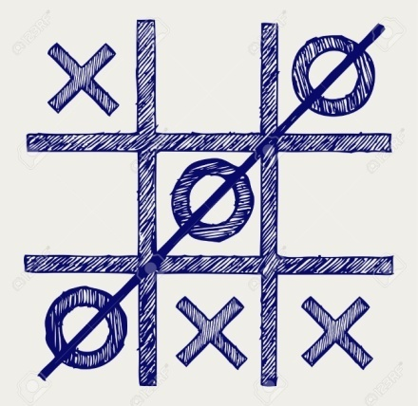
Why searching in AI?
May be you all are familiar with the board game Tic-Tac-Toe.
As an AI student, you want design an intelligent agent, which can play this game with you as an opponent.

Slide 3
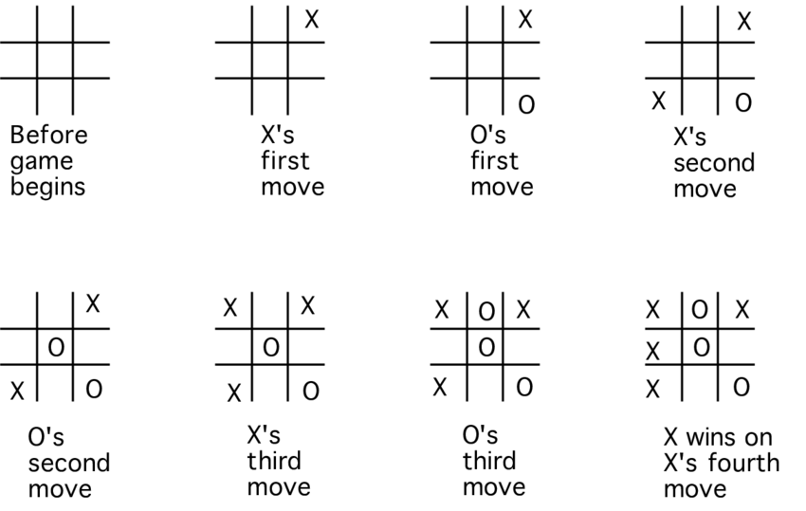
Why searching in AI?
Intelligent agent should know the current state of the Tic-Tac-Toe board.
Fig: Some states of Tic-Tac-Toe board.

Slide 4
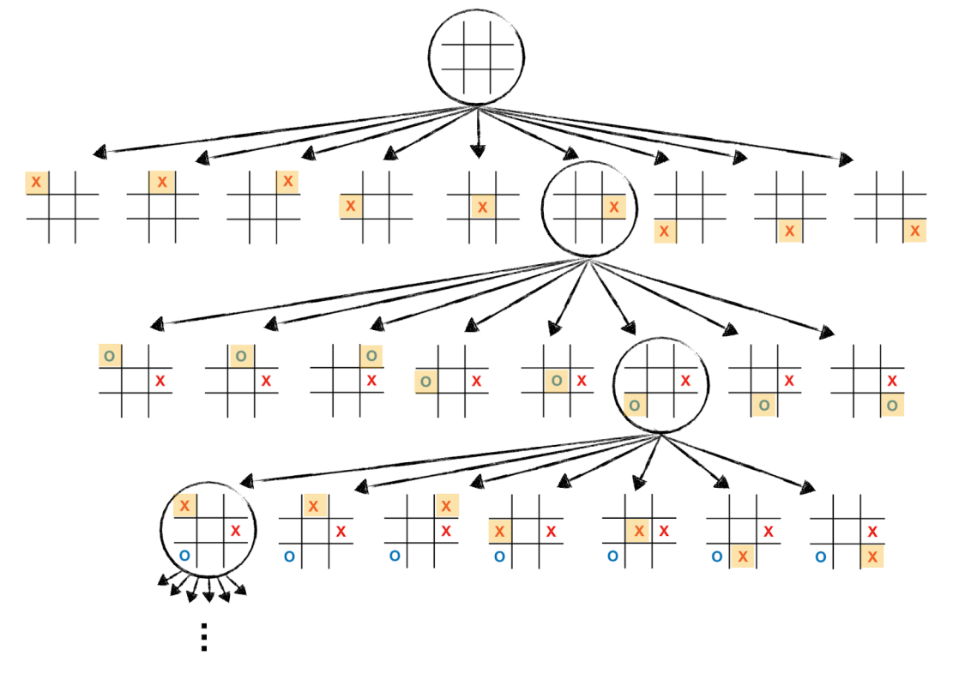
Why searching in AI?
Intelligent agent should explore the next possible movement and search for the best move to win the game.
Fig: Game search tree for Tic-Tac-Toe board (partial view)

Slide 5
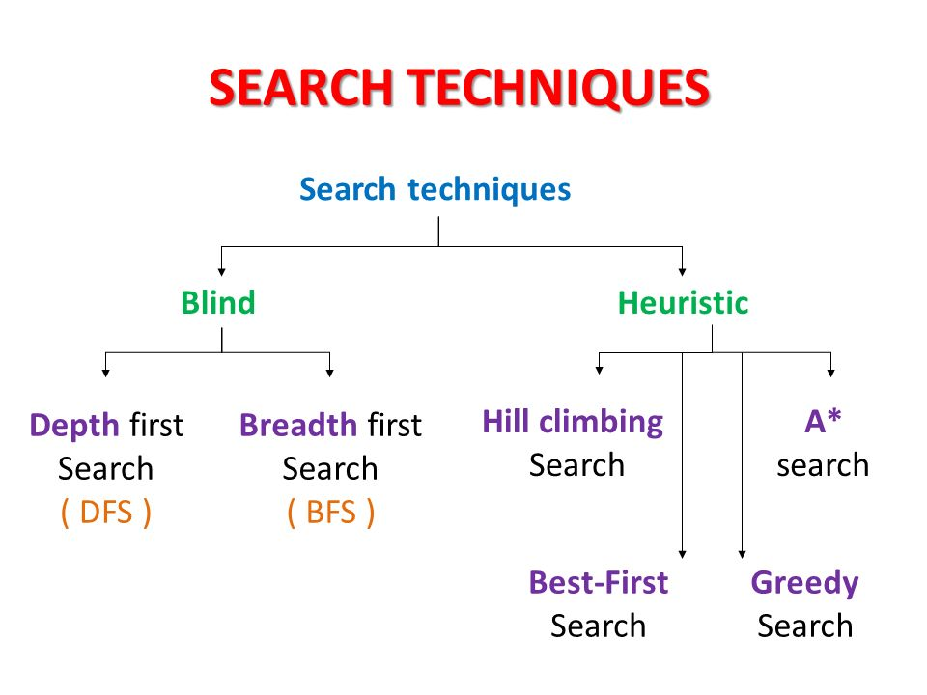
(uninformed Search)
(Informed Search)
Other blind search strategies are:
Depth-limited search (Extended DFS)
Iterative-deepening search (Extended DFS)
Uniform cost search
Bi-directional search

Slide 6
Uninformed Vs Informed Search
Uninformed search: Use only the information available in the problem definition. Example: breadth-first, depth-first, depth limited, iterative deepening, uniform cost and bidirectional search
Informed search: Use domain knowledge or heuristic to choose the best move. Example. Greedy best-first, A*, IDA*, and beam search
Additional Note:
optimization in which the search is to find an optimal value of an objective function: hill climbing, simulated annealing, genetic algorithms, Ant Colony Optimization
Game playing, an adversarial search: minimax algorithm, alpha-beta pruning

Slide 7
Uninformed Search

Slide 8
Breadth First Search
Application1:
Given the following state space (tree search), give the sequence of visited nodes when using BFS (assume that the nodeO is the goal state):
A
B
C
D
E
F
G
H
I
J
K
L
M
N
O

Slide 9
Breadth First Search
A,
A
B
C
D
E

Slide 10
Breadth First Search
A,
B,
A
B
C
D
E
F
G

Slide 11
Breadth First Search
A,
B,C
A
B
C
D
E
F
G
H

Slide 12
Breadth First Search
A,
B,C,D
A
B
C
D
E
F
G
H
I
J

Slide 13
Breadth First Search
A,
B,C,D,E
A
B
C
D
E
F
G
H
I
J

Slide 14
Breadth First Search
A,
B,C,D,E,
F,
A
B
C
D
E
F
G
H
I
J

Slide 15
Breadth First Search
A,
B,C,D,E,
F,G
A
B
C
D
E
F
G
H
I
J
K
L

Slide 16
Breadth First Search
A,
B,C,D,E,
F,G,H
A
B
C
D
E
F
G
H
I
J
K
L

Slide 17
Breadth First Search
A,
B,C,D,E,
F,G,H,I
A
B
C
D
E
F
G
H
I
J
K
L
M

Slide 18
Breadth First Search
A,
B,C,D,E,
F,G,H,I,J,
A
B
C
D
E
F
G
H
I
J
K
L
M
N

Slide 19
Breadth First Search
A,
B,C,D,E,
F,G,H,I,J,
K,
A
B
C
D
E
F
G
H
I
J
K
L
M
N

Slide 20
Breadth First Search
A,
B,C,D,E,
F,G,H,I,J,
K,L
A
B
C
D
E
F
G
H
I
J
K
L
M
N
O

Slide 21
Breadth First Search
A,
B,C,D,E,
F,G,H,I,J,
K,L, M,
A
B
C
D
E
F
G
H
I
J
K
L
M
N
O

Slide 22
Breadth First Search
A,
B,C,D,E,
F,G,H,I,J,
K,L, M,N,
A
B
C
D
E
F
G
H
I
J
K
L
M
N
O

Slide 23
Breadth First Search
A,
B,C,D,E,
F,G,H,I,J,
K,L, M,N,
Goal state: O
A
B
C
D
E
F
G
H
I
J
K
L
M
N
O

Slide 24
Breadth First Search
The returned solution is the sequence of operators in the path:
A, B, G, L, O
A
B
C
D
E
F
G
H
I
J
K
L
M
N
O

Slide 25
Depth First Search (DFS)
Application2:
Given the following state space (tree search), give the sequence of visited nodes when using DFS (assume that the nodeO is the goal state):
A
B
C
D
E
F
G
H
I
J
K
L
M
N
O

Slide 26
Depth First Search
A,
A
B
C
D
E

Slide 27
Depth First Search
A,B,
A
B
C
D
E
F
G

Slide 28
Depth First Search
A,B,F,
A
B
C
D
E
F
G

Slide 29
Depth First Search
A,B,F,
G,
A
B
C
D
E
F
G
K
L

Slide 30
Depth First Search
A,B,F,
G,K,
A
B
C
D
E
F
G
K
L

Slide 31
Depth First Search
A,B,F,
G,K,
L,
A
B
C
D
E
F
G
K
L
O

Slide 32
Depth First Search
A,B,F,
G,K,
L, O: Goal State
A
B
C
D
E
F
G
K
L
O

Slide 33
Depth First Search
The returned solution is the sequence of operators in the path: A, B, G, L, O
A
B
C
D
E
F
G
K
L
O

Slide 34
Depth-Limited Search (DLS)
Application3:
Given the following state space (tree search), give the sequence of visited nodes when using DLS (Limit = 2):
Limit = 0
A
Limit = 1
B
C
D
E
Limit = 2
F
G
H
I
J
K
L
M
N
O

Slide 35
Depth-Limited Search (DLS)
A,
A
B
C
D
E
Limit = 2

Slide 36
Depth-Limited Search (DLS)
A,B,
A
B
C
D
E
Limit = 2
F
G

Slide 37
Depth-Limited Search (DLS)
A,B,F,
A
B
C
D
E
Limit = 2
F
G

Slide 38
Depth-Limited Search (DLS)
A,B,F,
G,
A
B
C
D
E
Limit = 2
F
G

Slide 39
Depth-Limited Search (DLS)
A,B,F,
G,
C,
A
B
C
D
E
Limit = 2
F
G
H

Slide 40
Depth-Limited Search (DLS)
A,B,F,
G,
C,H,
A
B
C
D
E
Limit = 2
F
G
H

Slide 41
Depth-Limited Search (DLS)
A,B,F,
G,
C,H,
D,
A
B
C
D
E
Limit = 2
F
G
H
I
J

Slide 42
Depth-Limited Search (DLS)
A,B,F,
G,
C,H,
D,I
A
B
C
D
E
Limit = 2
F
G
H
I
J

Slide 43
Depth-Limited Search (DLS)
A,B,F,
G,
C,H,
D,I
J,
A
B
C
D
E
Limit = 2
F
G
H
I
J

Slide 44
Depth-Limited Search (DLS)
A,B,F,
G,
C,H,
D,I
J,
E
A
B
C
D
E
Limit = 2
F
G
H
I
J

Slide 45
Depth-Limited Search (DLS)
A,B,F,
G,
C,H,
D,I
J,
E, Failure
A
B
C
D
E
Limit = 2
F
G
H
I
J

Slide 46
Depth-Limited Search (DLS)
DLS algorithm returns Failure (no solution)
The reason is that the goal is beyond the limit (Limit =2): the goal depth is (d=4)
A
B
C
D
E
Limit = 2
F
G
H
I
J
K
L
M
N
O

Slide 47
Iterative Deepening Search (IDS)
Application4:
Given the following state space (tree search), give the sequence of visited nodes when using IDS:
Limit = 0
A
Limit = 1
B
C
D
E
Limit = 2
F
G
H
I
J
Limit = 3
K
L
M
N
Limit = 4
O

Slide 48
Iterative Deepening Search (IDS)
DLS with bound = 0

Slide 49
Iterative Deepening Search (IDS)
A,
Limit = 0
A

Slide 50
Iterative Deepening Search (IDS)
A, Failure
Limit = 0
A

Slide 51
Iterative Deepening Search (IDS)
DLS with bound = 1

Slide 52
Iterative Deepening Search (IDS)
A,
A
Limit = 1
B
C
D
E

Slide 53
Iterative Deepening Search (IDS)
A,B,
A
Limit = 1
B
C
D
E

Slide 54
Iterative Deepening Search (IDS)
A,B,
C,
A
Limit = 1
B
C
D
E

Slide 55
Iterative Deepening Search (IDS)
A,B,
C,
D,
A
Limit = 1
B
C
D
E

Slide 56
Iterative Deepening Search (IDS)
A,B
C,
D,
E,
A
Limit = 1
B
C
D
E

Slide 57
Iterative Deepening Search (IDS)
A,B,
C,
D,
E, Failure
A
Limit = 1
B
C
D
E

Slide 58
Iterative Deepening Search (IDS)
A,
A
B
C
D
E
Limit = 2

Slide 59
Iterative Deepening Search (IDS)
A,B,
A
B
C
D
E
Limit = 2
F
G

Slide 60
Iterative Deepening Search (IDS)
A,B,F,
A
B
C
D
E
Limit = 2
F
G

Slide 61
Iterative Deepening Search (IDS)
A,B,F,
G,
A
B
C
D
E
Limit = 2
F
G

Slide 62
Iterative Deepening Search (IDS)
A,B,F,
G,
C,
A
B
C
D
E
Limit = 2
F
G
H

Slide 63
Iterative Deepening Search (IDS)
A,B,F,
G,
C,H,
A
B
C
D
E
Limit = 2
F
G
H

Slide 64
Iterative Deepening Search (IDS)
A,B,F,
G,
C,H,
D,
A
B
C
D
E
Limit = 2
F
G
H
I
J

Slide 65
Iterative Deepening Search (IDS)
A,B,F,
G,
C,H,
D,I
A
B
C
D
E
Limit = 2
F
G
H
I
J

Slide 66
Iterative Deepening Search (IDS)
A,B,F,
G,
C,H,
D,I
J,
A
B
C
D
E
Limit = 2
F
G
H
I
J

Slide 67
Iterative Deepening Search (IDS)
A,B,F,
G,
C,H,
D,I
J,
E
A
B
C
D
E
Limit = 2
F
G
H
I
J

Slide 68
Iterative Deepening Search (IDS)
A,B,F,
G,
C,H,
D,I
J,
E, Failure
A
B
C
D
E
Limit = 2
F
G
H
I
J
K
L
M
N
O

Slide 69
Iterative Deepening Search (IDS)
DLS with bound = 3

Slide 70
Iterative Deepening Search (IDS)
A,
A
B
C
D
E
Limit = 3

Slide 71
Iterative Deepening Search (IDS)
A,B,
A
B
C
D
E
F
G
Limit = 3

Slide 72
Iterative Deepening Search (IDS)
A,B,F,
A
B
C
D
E
F
G
Limit = 3

Slide 73
Iterative Deepening Search (IDS)
A,B,F,
G,
A
B
C
D
E
F
G
Limit = 3
K
L

Slide 74
Iterative Deepening Search (IDS)
A,B,F,
G,K,
A
B
C
D
E
F
G
Limit = 3
K
L

Slide 75
Iterative Deepening Search (IDS)
A,B,F,
G,K,
L,
A
B
C
D
E
F
G
Limit = 3
K
L

Slide 76
Iterative Deepening Search (IDS)
A,B,F,
G,K,
L,
C,
A
B
C
D
E
F
G
H
Limit = 3
K
L

Slide 77
Iterative Deepening Search (IDS)
A,B,F,
G,K,
L,
C,H,
A
B
C
D
E
F
G
H
Limit = 3
K
L

Slide 78
Iterative Deepening Search (IDS)
A,B,F,
G,K,
L,
C,H,
D,
A
B
C
D
E
F
G
H
I
J
Limit = 3
K
L

Slide 79
Iterative Deepening Search (IDS)
A,B,F,
G,K,
L,
C,H,
D,I,
A
B
C
D
E
F
G
H
I
J
Limit = 3
K
L
M

Slide 80
Iterative Deepening Search (IDS)
A,B,F,
G,K,
L,
C,H,
D,I,M,
A
B
C
D
E
F
G
H
I
J
Limit = 3
K
L
M

Slide 81
Iterative Deepening Search (IDS)
A,B,F,
G,K,
L,
C,H,
D,I,M,
J,
A
B
C
D
E
F
G
H
I
J
Limit = 3
K
L
M
N

Slide 82
Iterative Deepening Search (IDS)
A,B,F,
G,K,
L,
C,H,
D,I,M,
J,N,
A
B
C
D
E
F
G
H
I
J
Limit = 3
K
L
M
N

Slide 83
Iterative Deepening Search (IDS)
A,B,F,
G,K,
L,
C,H,
D,I,M,
J,N,
E,
A
B
C
D
E
F
G
H
I
J
Limit = 3
K
L
M
N

Slide 84
Iterative Deepening Search (IDS)
A,B,F,
G,K,
L,
C,H,
D,I,M,
J,N,
E,Failure
A
B
C
D
E
F
G
H
I
J
Limit = 3
K
L
M
N
O

Slide 85
Iterative Deepening Search (IDS)
DLS with bound = 4

Slide 86
Iterative Deepening Search (IDS)
A,
A
B
C
D
E
Limit = 4

Slide 87
Iterative Deepening Search (IDS)
A,B,
A
B
C
D
E
F
G
Limit = 4

Slide 88
Iterative Deepening Search (IDS)
A,B,F,
A
B
C
D
E
F
G
Limit = 4

Slide 89
Iterative Deepening Search (IDS)
A,B,F,
G,
A
B
C
D
E
F
G
K
L
Limit = 4

Slide 90
Iterative Deepening Search (IDS)
A,B,F,
G,K,
A
B
C
D
E
F
G
K
L
Limit = 4

Slide 91
Iterative Deepening Search (IDS)
A,B,F,
G,K,
L,
A
B
C
D
E
F
G
K
L
Limit = 4
O

Slide 92
Iterative Deepening Search (IDS)
A,B,F,
G,K,
L, O: Goal State
A
B
C
D
E
F
G
K
L
Limit = 4
O

Slide 93
Iterative Deepening Search (IDS)
The returned solution is the sequence of operators in the path: A, B, G, L, O
A
B
C
D
E
F
G
K
L
O

Slide 94
Uniform Cost Search (UCS)
Main idea: Uniform-cost Search: Expand node with smallest path cost g(n).
Implementation:
Enqueue nodes in order of cost g(n).
QUEUING-FN:- insert in order of increasing path cost.
Enqueue new node at the appropriate position in the queue so that we dequeue the cheapest node.
Complete? Yes.
Optimal? Yes, if path cost is nondecreasing function of depth
Time Complexity: O(b^{d})
Space Complexity: O(b^{d}), note that every node in the fringe keep in the queue.

Slide 95
Uniform Cost Search (UCS)
5
2
[5]
[2]
1
4
1
7
[6]
[3]
[9]
[9]
Goal state
4
5
x(n) = g(n)
path cost of node n
[7]
[8]

Slide 96
Uniform Cost Search (UCS)
5
2
[5]
[2]

Slide 97
Uniform Cost Search (UCS)
5
2
[5]
[2]
1
7
[3]
[9]

Slide 98
Uniform Cost Search (UCS)
5
2
[5]
[2]
1
7
[3]
[9]
4
5
[7]
[8]

Slide 99
Uniform Cost Search (UCS)
5
2
[5]
[2]
1
4
1
7
[6]
[3]
[9]
[9]
4
5
[7]
[8]

Slide 100
Uniform Cost Search (UCS)
5
2
[5]
[2]
Goal state path cost g(n)=[6]
1
4
1
7
[3]
[9]
[9]
4
5
[7]
[8]

Slide 101
Uniform Cost Search (UCS)
5
2
[5]
[2]
1
4
1
7
[6]
[3]
[9]
[9]
4
5
[7]
[8]

Slide 102
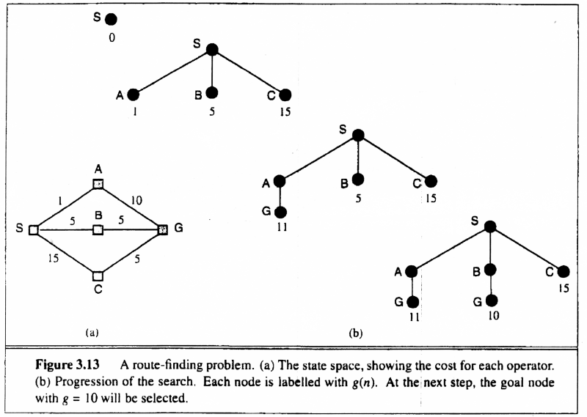
Uniform-cost search
Breadth-first is only optimal if step costs is increasing with depth (e.g. constant). Can we guarantee optimality for any step cost?

Slide 103
Example for Illustrating Search Strategies
S
3
8
1
A
B
C
3
15
7
20
5
D
E
G

Slide 104
Depth-First Search
S
3
1
8
A
B
C
3
15
7
20
Expanded node Nodes list
{ S⁰ }
S⁰ { A³ B¹ C⁸ }
A³ { D⁶ E¹⁰ G¹⁸ B¹ C⁸ }
D⁶ { E¹⁰ G¹⁸ B¹ C⁸ }
E¹⁰ { G¹⁸ B¹ C⁸ }
G¹⁸ { B¹ C⁸ }
Solution path found is S A G, cost 18
Number of nodes expanded (including goal node) = 5
5
D
E
G

Slide 105
Breadth-First Search
S
3
1
8
A
B
C
Expanded node Nodes list
{ S⁰ }
S⁰ { A³ B¹ C⁸ }
A³ { B¹ C⁸ D⁶ E¹⁰ G¹⁸ }
B¹ { C⁸ D⁶ E¹⁰ G¹⁸ G²¹ }
C⁸ { D⁶ E¹⁰ G¹⁸ G²¹ G¹³ }
D⁶ { E¹⁰ G¹⁸ G²¹ G¹³ }
E¹⁰ { G¹⁸ G²¹ G¹³ }
G¹⁸ { G²¹ G¹³ }
Solution path found is S A G , cost 18
Number of nodes expanded (including goal node) = 7
3
15
7
20
5
D
E
G

Slide 106
Uniform-Cost Search
S
3
1
8
Expanded node Nodes list
{ S⁰ }
S⁰ { B¹ A³ C⁸ }
B¹ { A³ C⁸ G²¹ }
A³ { D⁶ C⁸ E¹⁰ G¹⁸ }
D⁶ { C⁸ E¹⁰ G¹⁸ }
C⁸ { E¹⁰ G¹³}
E¹⁰ { G¹³}
G¹³ {}
Solution path found is S C G, cost 13
Number of nodes expanded (including goal node) = 7
A
B
C
3
15
7
20
5
D
E
G

Slide 107
Bidirectional Search
Idea
simultaneously search forward from S and backwards from G
stop when both “meet in the middle”
need to keep track of the intersection of 2 open sets of nodes
What does searching backwards from G mean
need a way to specify the predecessors of G
this can be difficult,
e.g., predecessors of checkmate in chess?
what if there are multiple goal states?
what if there is only a goal test, no explicit list?

Slide 108
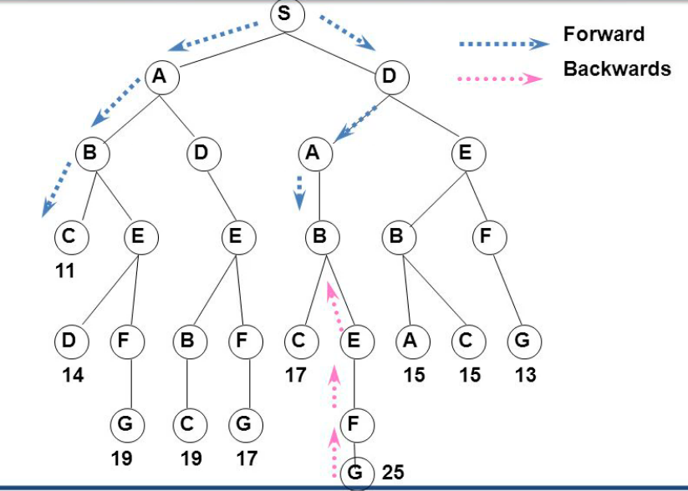
Bidirectional Search

Slide 109
What Criteria are used to Compare different search techniques ?
As we are going to consider different techniques to search the problem space, we need to consider what criteria we will use to compare them.
Completeness: Is the technique guaranteed to find an answer (if there is one).
Optimality/Admissibility : does it always find a least-cost solution?
- an admissible algorithm will find a solution with minimum cost
Time Complexity: How long does it take to find a solution.
Space Complexity: How much memory does it take to find a solution.

Slide 110
Time and Space Complexity ?
Time and space complexity are measured in terms of:
The average number of new nodes we create when expanding a new node is the (effective) branching factor b.
The (maximum) branching factor b is defined as the maximum nodes created when a new node is expanded.
The length of a path to a goal is the depth d.
The maximum length of any path in the state space m.

Slide 111
Properties of breadth-first search
Complete? Yes it always reaches goal (if b is finite)
Time? 1+b+b²+b³+… +b^{d} + (b^{d+1}-b)) = O(b^{d+1})
(this is the number of nodes we generate)
Space? O(b^{d+1}) (keeps every node in memory,
either in fringe or on a path to fringe).
Optimal? Yes (if we guarantee that deeper solutions are less optimal, e.g. step-cost=1).
Space is the bigger problem (more than time)

Slide 112
Properties of depth-first search
Complete? No: fails in infinite-depth spaces
Can modify to avoid repeated states along path
Time? O(b^{m}) with m=maximum depth
terrible if m is much larger than d
but if solutions are dense, may be much faster than
breadth-first
Space? O(bm), i.e., linear space! (we only need to
remember a single path + expanded unexplored nodes)
Optimal? No (It may find a non-optimal goal first)

Slide 113
Properties of iterative deepening search
Complete? Yes
Time? (d+1)b⁰ + d b¹ + (d-1)b² + … + b^{d} = O(b^{d})
Space? O(bd)
Optimal? Yes, if step cost = 1 or increasing function of depth.

Slide 114
Uniform-cost search
Implementation: fringe = queue ordered by path cost
Equivalent to breadth-first if all step costs all equal.
Complete? Yes, if step cost ≥ ε
(otherwise it can get stuck in infinite loops)
Time? # of nodes with path cost ≤ cost of optimal solution.
Space? # of nodes on paths with path cost ≤ cost of optimal
solution.
Optimal? Yes, for any step cost.

Slide 115
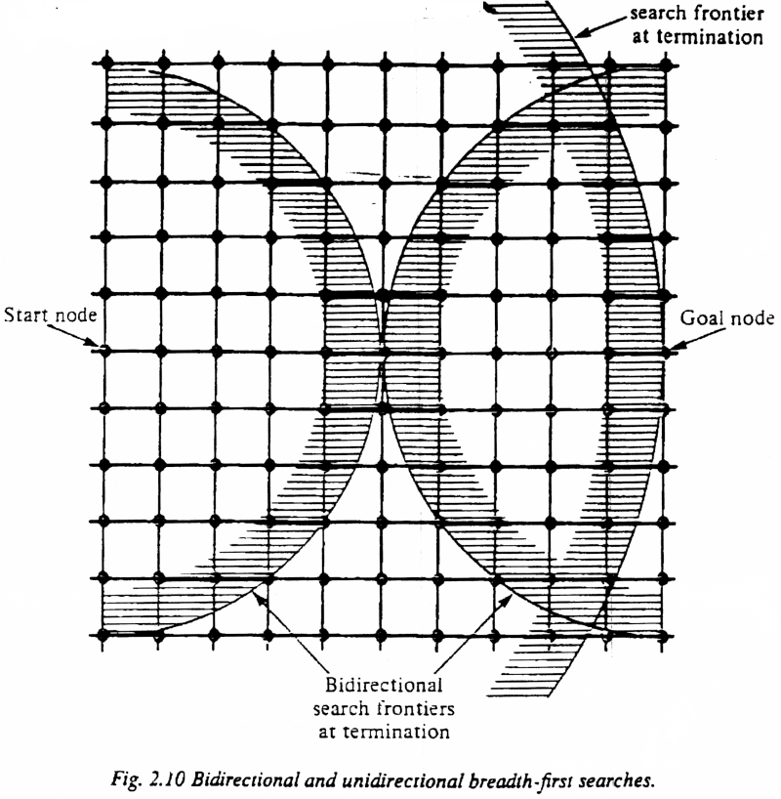
Bi-Directional Search
Complexity: time and space complexity are:

Slide 116
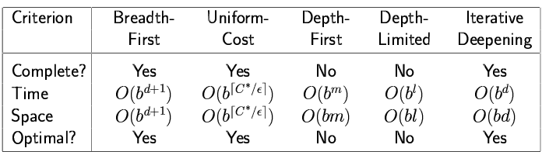
Summary of algorithms

